Slide 1
Design Management

Slide 2
What is Design Management?
DM provides capabilities for in-context collaboration, traceability and impact analysis, agile sketching and domain modeling. Design Management supports a collaborative approach to software and systems architecture and design. By integrating design management into the Rational solution for Collaborative Lifecycle Management (CLM), you can associate all types of software and systems designs with other lifecycle resources such as requirements, change requests, and test artifacts. Software architects, system engineers, developers, and deployment planners can collaborate with peers, subject matter experts, clients, and other stakeholders over the Internet.

Slide 3
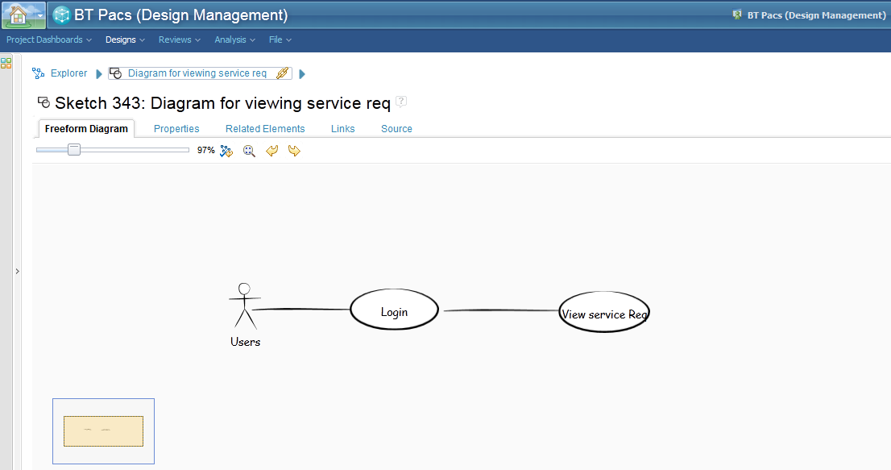
Simple Sketch for a Requirement

Slide 4
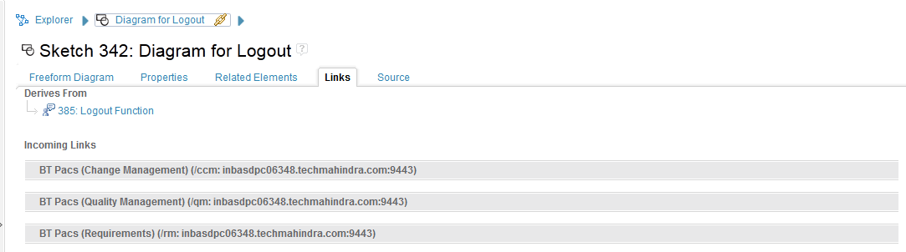
Linking the Design and Requirement
We can link the free style diagram for any requirement to the respective stories. This way we can navigate to the design from the requirement and check the traceability.

